Slide 1





1. Concepting
Summary of Critical Report
Audience
Storyboarding
Full team

Slide 2
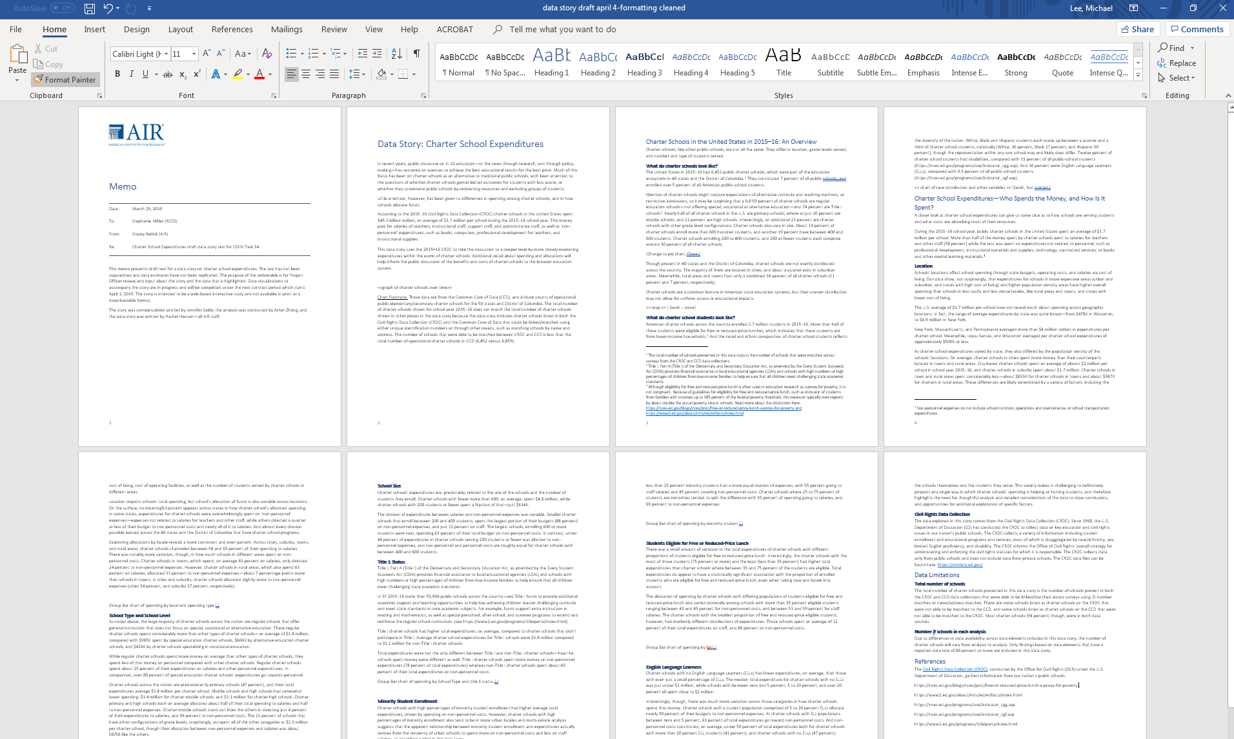
1. Concepting
Summary of Critical Report
Audience
Storyboarding
Key questions:
What is the goal of creating this data story?
What are the research questions of interest?
What are the most critical findings?
What artifacts supplement these findings?
Full team

Slide 3

1. Concepting
Summary of Critical Report
Audience
Storyboarding
Key questions:
What is the primary audience this story is trying to reach?
What do users need to know to better understand the subject of the story?
What can we build to support the telling of the story?
Source: https://www.air.org/project/national-survey-public-education-s-response-covid-19
Full team
Notes:
AIR’s audience is typically educators, policymakers, and researchers we seek to inform future education practices

Slide 4
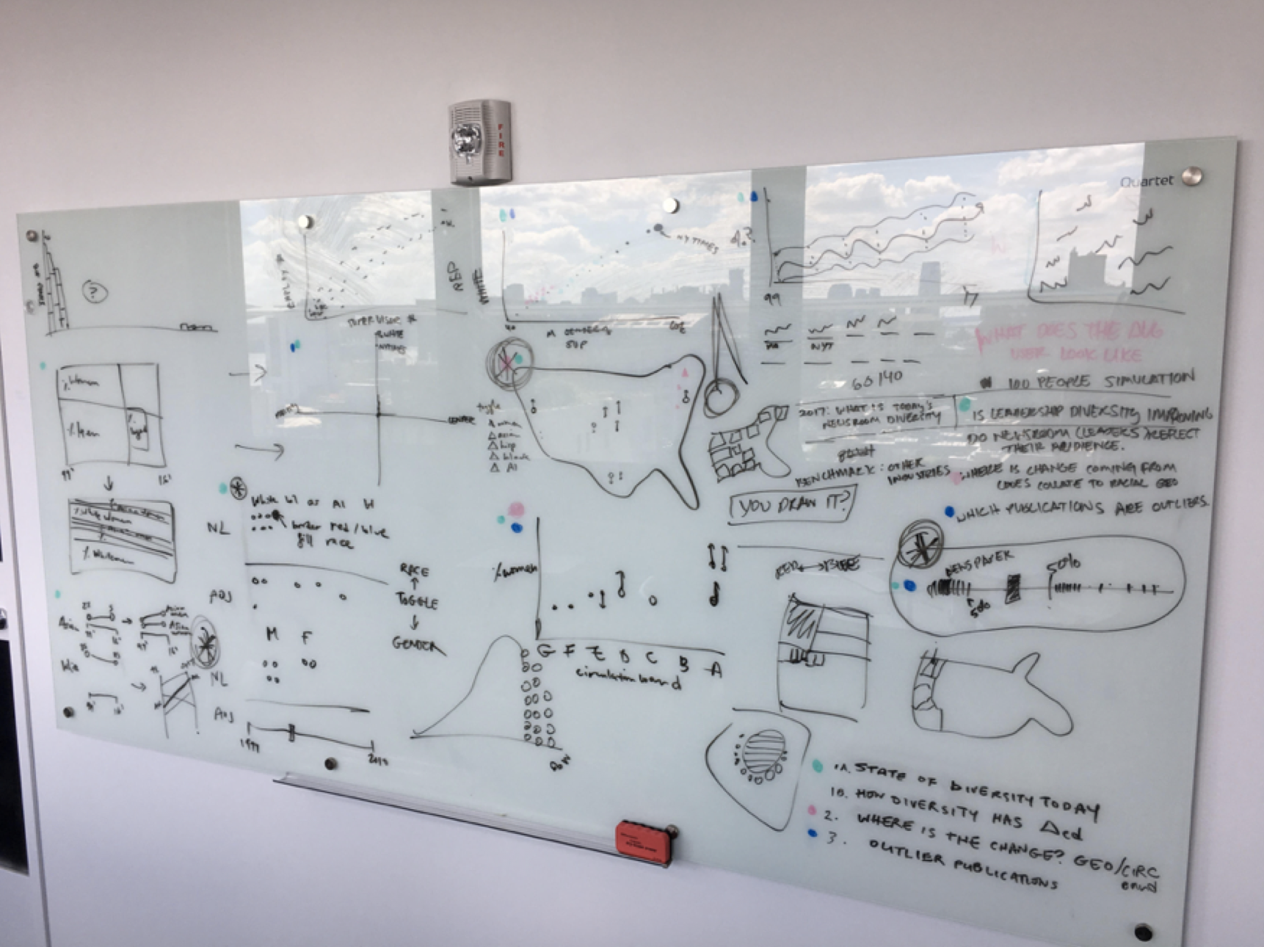
1. Concepting
Summary of Critical Report
Audience
Storyboarding
Key questions:
What display of text, artifacts, etc., portrays the most critical findings?
How does the narrative integrate with the artifacts?
What artifacts might be supplemented by interactivity?
Responsiveness?
Source: The Pudding
Full team

Slide 5
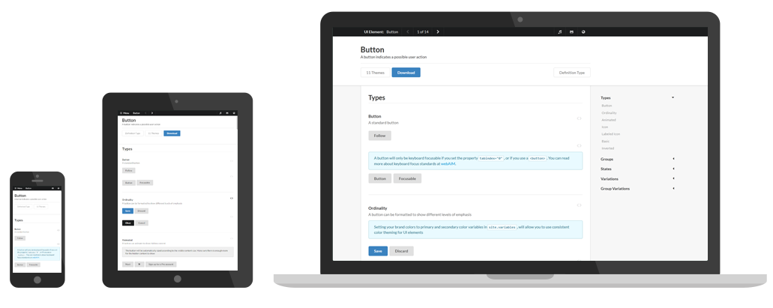
1. Concepting
Summary of Critical Report
Audience
Storyboarding
Key questions:
What display of text/artifacts/etc. portrays the most critical findings?
What artifacts might be supplemented by interactivity?
What similar work can be used for inspiration?
Responsiveness?
Development team

Slide 6
2. Development
Wireframe
Data Preparation and Visualization
Web App Development
Development team

Slide 7
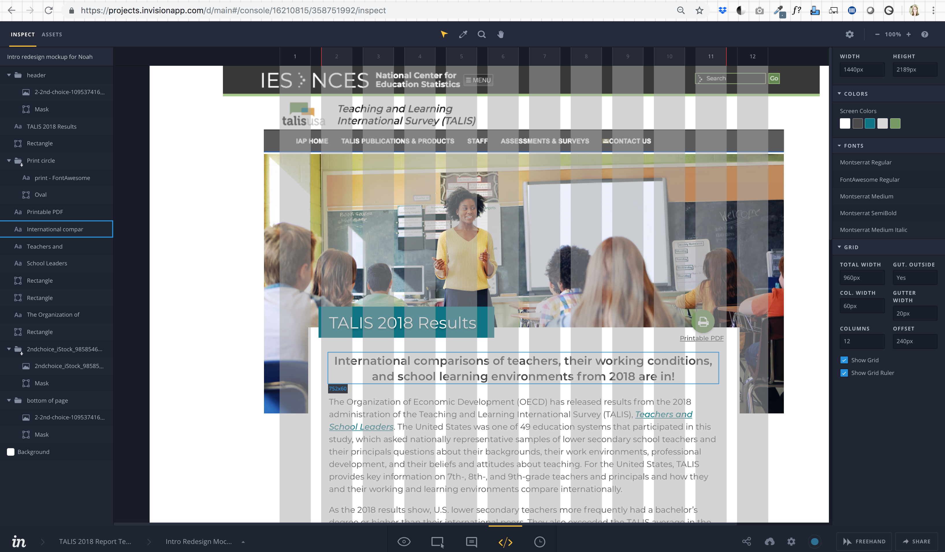


2. Development
Wireframe
Data Preparation and Visualization
Web App Development
Key questions:
What design(s) might facilitate an optimal user experience?
How might an alternative approach influence the reach and the user’s understanding of the story?
What graphic design information is necessary for the story’s development?
Graphic Designer
Notes:
Graphic designers are focused on the design of the story and creating a close-to-functional prototype to assist the review and content team in simulating a user experience – what constraints are there on the production site (see: Nation’s Report Card)? What functionality requires collaboration with the web developer or data developer?

Slide 8
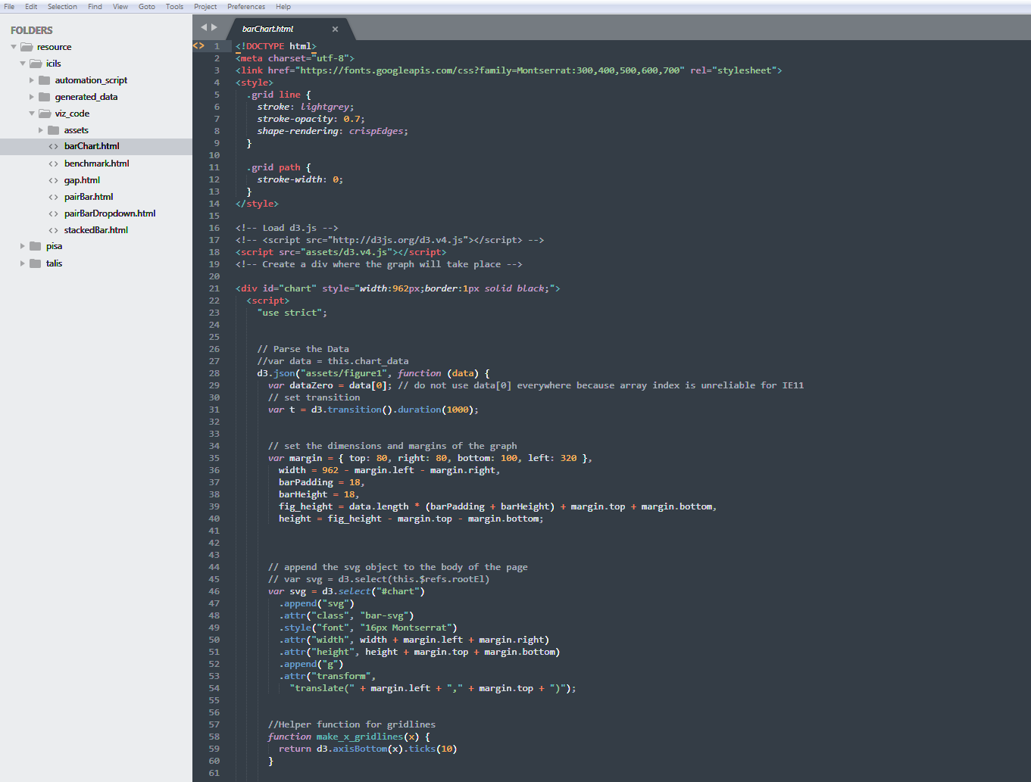
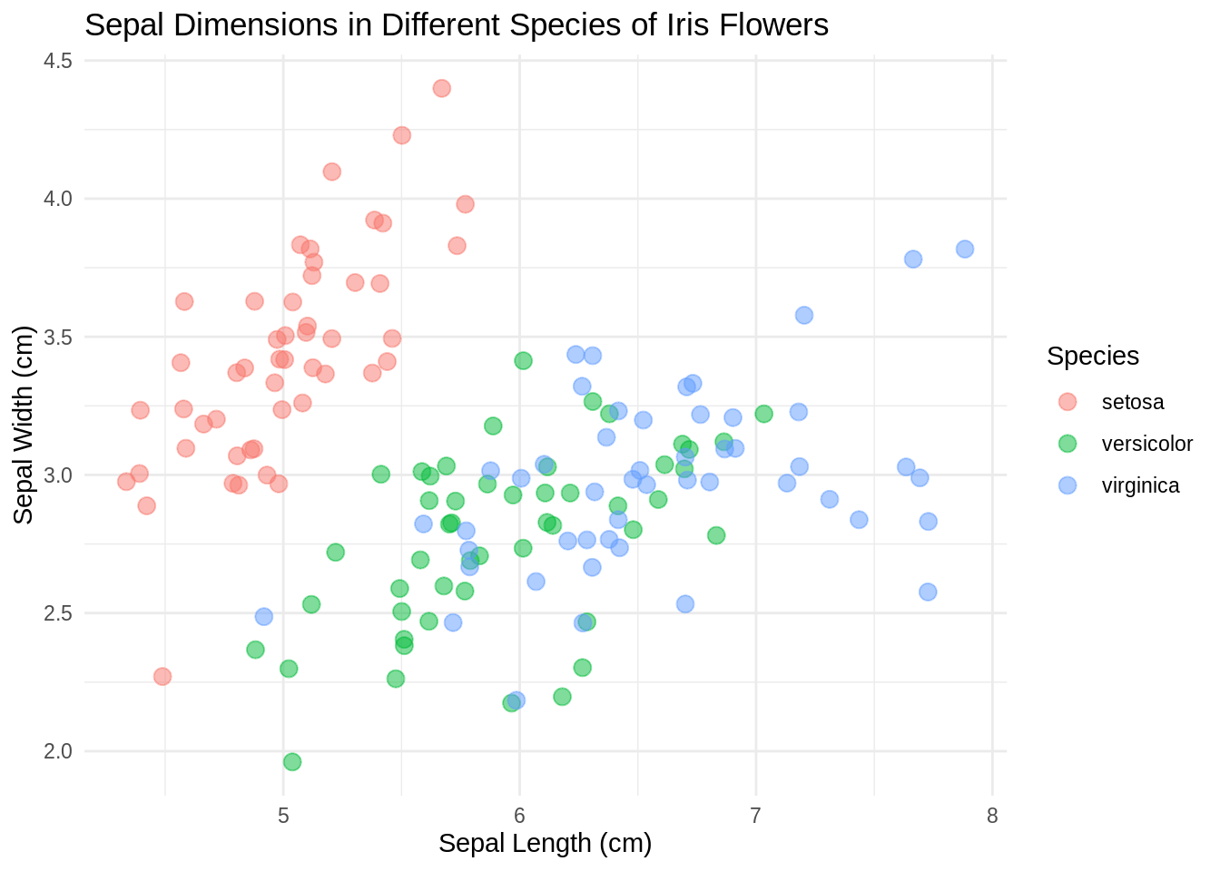


2. Development
Wireframe
Data Preparation and Visualization
Web App Development
Key questions:
What design(s) might facilitate an optimal user experience?
How might an alternative approach influence the reach and the user’s understanding of the story?
What data information is necessary for display?
Data Developer
Notes:
Data developers are focused on the technical issues relating to data and visualizations populating the story – what format (csv, json, etc) should the data be in? What functionality requires collaboration with the web developer?

Slide 9
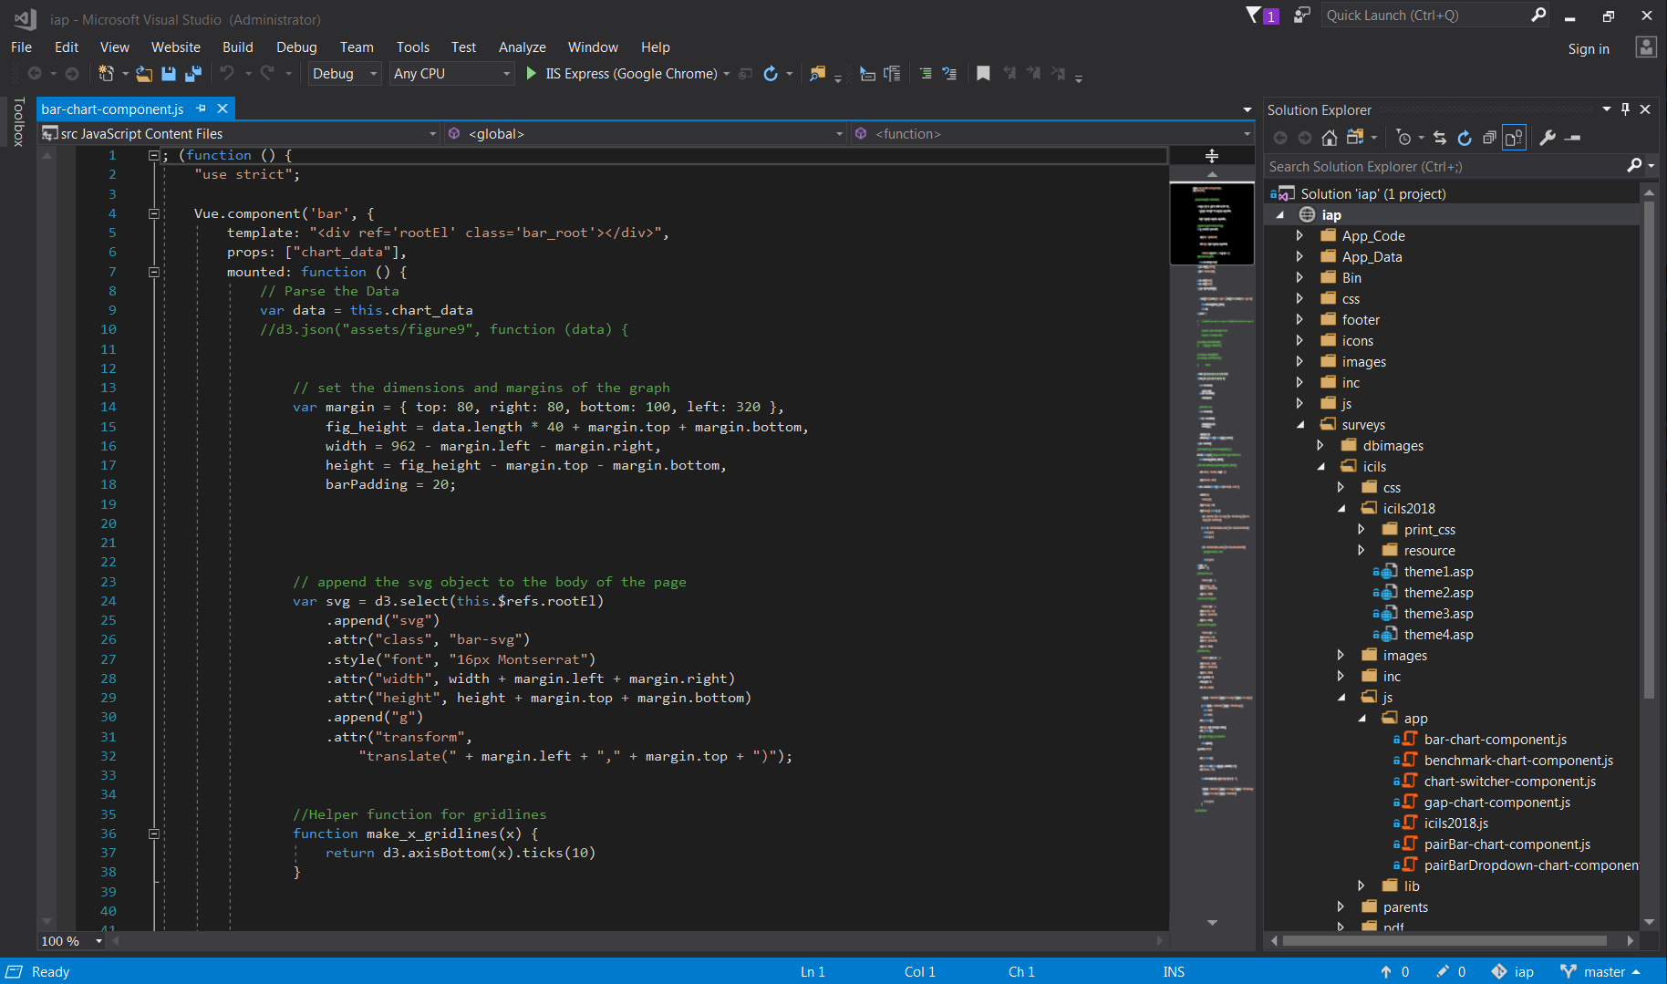



2. Development
Wireframe
Data Preparation and Visualization
Web App Development
Key questions:
What design(s) might facilitate an optimal user experience?
How might an alternative approach influence the reach and the user’s understanding of the story?
What web app considerations are necessary for display?
Web Developer
Notes:
Web Developers are focused on creating a functional web app based on the wireframe in tandem with the contents of the visualizations – what constraints are there on the production site (see: Nation’s Report Card)? What functionality requires collaboration with the web developer or data developer?

Slide 10
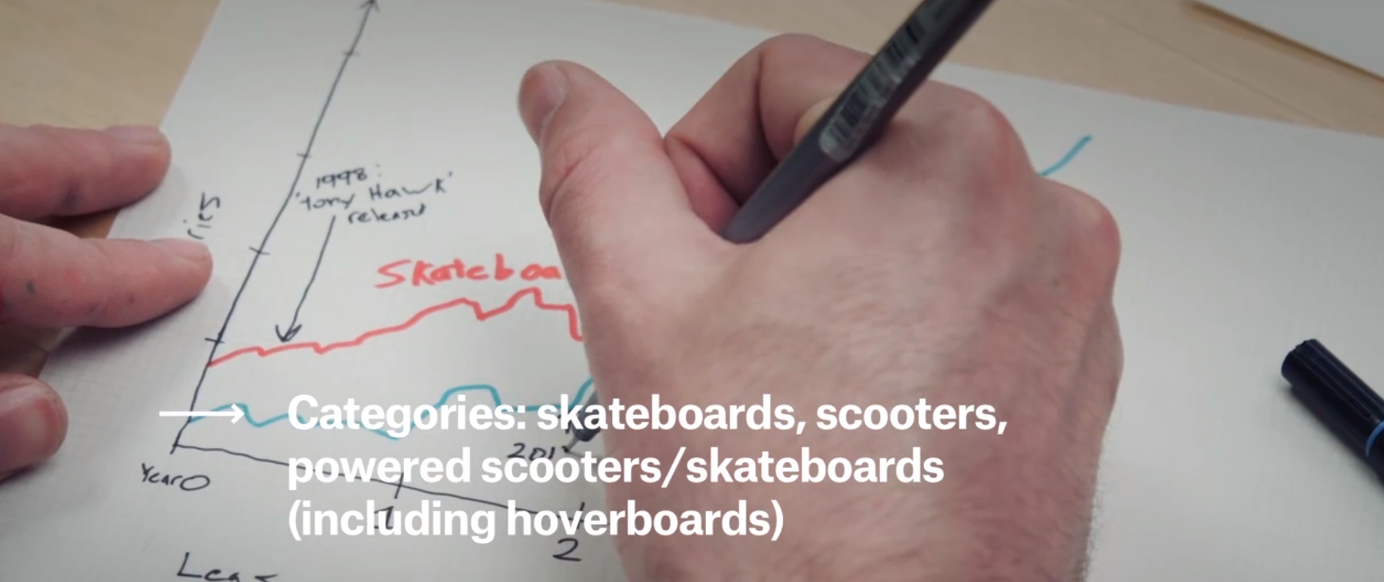
2. Development
Source: https://fivethirtyeight.com/features/christmas-2015-was-filled-with-hoverboards-and-hoverboard-injuries/
Notes:
https://fivethirtyeight.com/features/christmas-2015-was-filled-with-hoverboards-and-hoverboard-injuries/ Embedded video: https://abcnews.go.com/fivethirtyeight/video/fivethirtyeight-quickdraw-hoverboards-skateboards-55952837
Takeaway – data story development is a collaborative process that benefits from intentional concepting and storyboarding before going into development. This process is assisted through the use of drawing, pitching ideas, and statistical software for quick data visualization mockups.

Slide 11
Activity Two – How might you present this differently?
Using your data story of interest, consider the design and data used to populate a table or figure. How could this be represented differently or improved upon? Using materials available at your desk, draw out an alternative rendering.
Discuss with your group and be prepared to share with everyone!
Notes:
NOTE BEFORE BREAKING: the breakout rooms may not be able to track the notes you take upon returning to the whole group. You are encouraged to take notes on your machine

Slide 12
3. Review
Internal Review
Revisions from Internal Review
Client Review
Revisions from Client Review
Full team

Slide 13

3. Review
Internal Review
Revisions from Internal Review
Client Review
Revisions from Client Review
Key questions:
What is the goal of creating this data story?
Does an artifact facilitate an understanding of the subject of the story?
What assumptions are we making with an artifact that might be expressed more effectively?
What considerations made during the concepting phases might further improve the data story?
Review team

Slide 14
3. Review
Internal Review
Revisions from Internal Review
Client Review
Revisions from Client Review
Key questions:
What is the priority of tasks in the project backlog?
What considerations made during the concepting/development phases might further improve the data story?
What must be done to ensure the delivery meets usability standards?
Development team

Slide 15
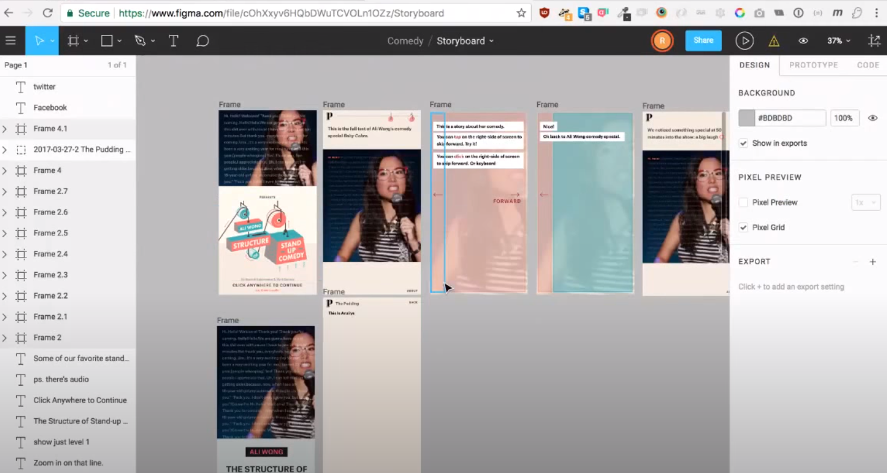
3. Review
Source: https://youtu.be/SQ7DiSW-C4k?t=851
Notes:
https://www.youtube.com/watch?v=SQ7DiSW-C4k&t=851s 14:11 – 17:00
The Structure of Stand-Up Comedy.: https://pudding.cool/2018/02/stand-up/
Takeaway – data story development is an iterative process requiring multiple reviews. This process is assisted through the use of collaborative wireframing software.

Slide 16
Activity Three – What all made up this wireframe?
Using your data story of interest, consider the different page “states” that occur and components that exist as you navigate the page. What might a wireframe for this article look like? Using materials available at your desk, draw out what each frame or page state might look like.
Discuss with your group and be prepared to share with everyone!
Notes:
NOTE BEFORE BREAKING: the breakout rooms may not be able to track the notes you take upon returning to the whole group. You are encouraged to take notes on your machine

Slide 17
4. Production
Final Testing
Move Development Environment to Live Site
Web Developer

Slide 18
4. Production
Final Testing
Move Development Environment to Live Site
Key questions:
Does the production version meet all web standards?
What accessibility implications must be further refined?
Web Developer

Slide 19
4. Production
Final Testing
Move Development Environment to Live Site
Key questions:
What can be used to share and promote the project?
What documentation and code can serve as a reference for future work?
Web Developer

Slide 20
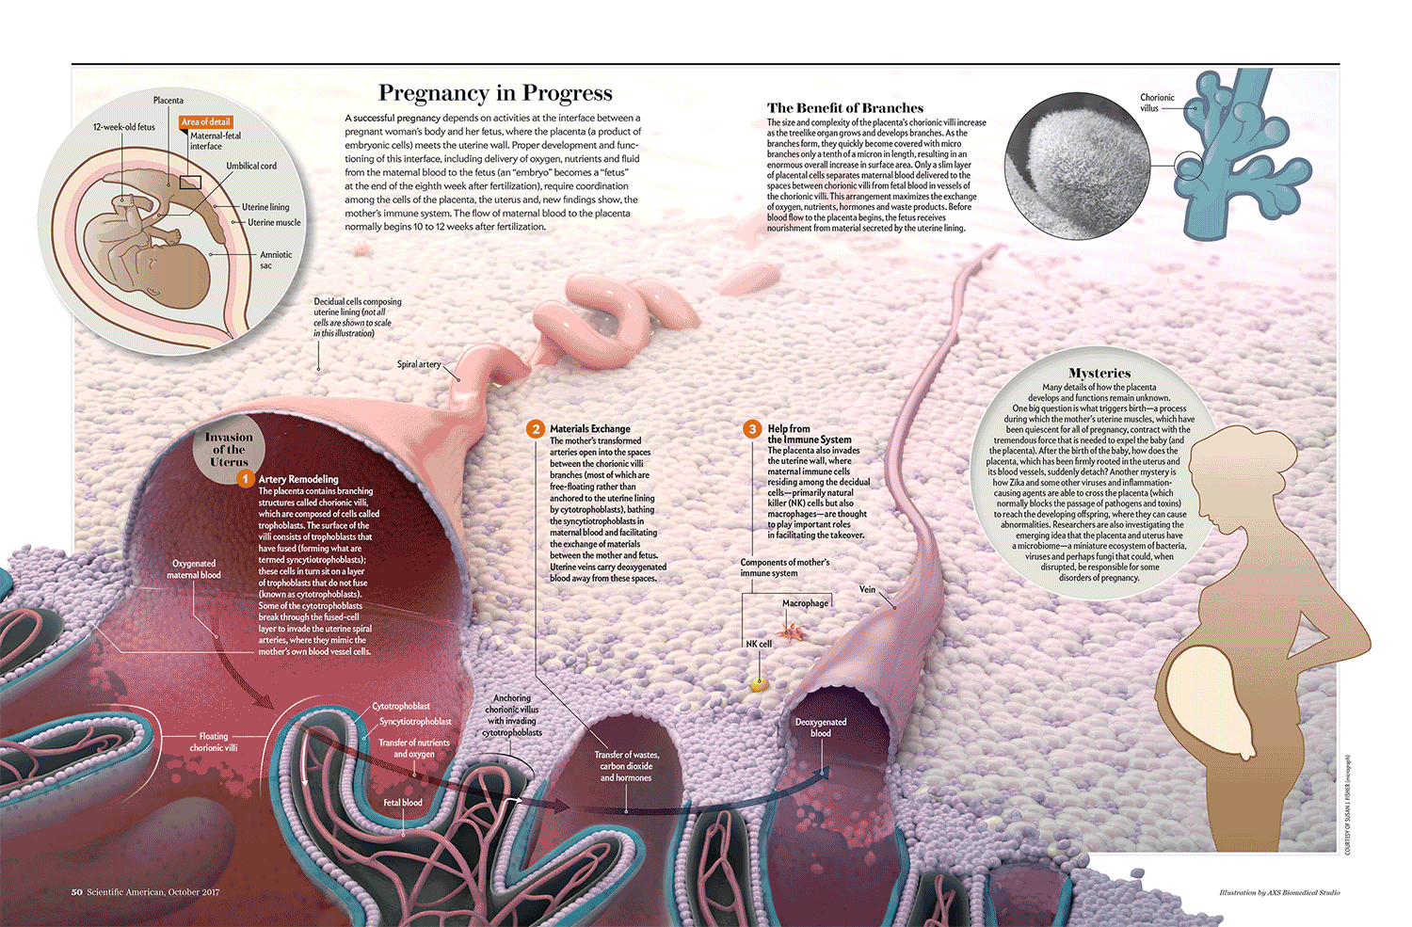
Wrap-up
How best do you come up with ideas?
Get friendly with coding
Wireframes will evolve
Keep asking questions
Build skills as they come
Remember your audience
Source: https://pudding.cool/process/how-to-make-dope-shit-part-2/
Notes:
Other topics, not discussed: web standards, accessibility, user testing, creative writing, technical writing, user experience design

Slide 21
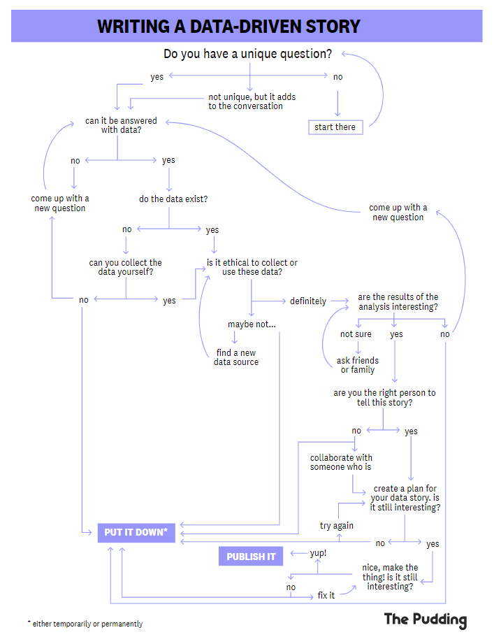
Resources
The Pudding (processes)
Data Stories Podcast
NYT Upshot
FiveThirtyEight
Source: https://pudding.cool/process/how-to-make-dope-shit-part-1/

Slide 22
Questions?

